Slide 1
ESCRIBA Enterprise Document Services (EDS)
Name – Job Title
Notes:
Ziel der Präsentation: Wir werden untersuchen, wie Agentic AI und HR Service Management zusammenwirken, um Personalprozesse zu transformieren.
Wichtigkeit des Themas: HR-Abteilungen sind in einem dynamischen Umfeld tätig und benötigen innovative Lösungen, um Mitarbeiter zu gewinnen, zu betreuen und zu entwickeln.

Slide 2












Significant Use Cases
Personnel-related documents for over 110,000 employees across Europe
Deeply integrated with ERP and CRM systems for error-free, bidirectional data exchange
345 HR specialists for documents and processes for >95,000 international employees
Integration into SAP, SuccessFactors, e-files, workflows
Automated template checks & direct processing via the SAP portal
Few months implementation phase
Around 3 million new contracts + a wide range of other documents per year
Creating complex project quotations in eight languages
Fully integrated into SAP message processing
Increased scalability and efficiency, saving up to one hour per project quotation
Centralized HR document management for around 390,000 employees
Replaced legacy systems
Seamless integration with SAP SuccessFactors.
4,100 students, and 2,500 scientists working in over 60 clinics and institutions
Streamlined its HR document creation replacing over 800 templates with 120 SAP-integrated template sets
Automatic generation of >1,000 documents daily
Short-term set-up of volunteer program for reorganization project
Automated offer and contract generation
Individualized Covid employee information documents for 200,000 employees
Set-up and dispatching across all channels within 2 days
>25 Interface languages | 50 Document languages
1⁺M
USERS
ALL INDUSTRIES
& VERTICALS
ENTERPRIZES WITH
>2,500 EMPLOYEES
Notes:
Covid Tests – Christian
Bullet Points
Across all industries and verticals, more than 1 million users worldwide, enterprizes with 2,500+ employees

Slide 3














Document Generation Complexity
60%
Blind generation/ dark processing
30%
Individual documents of medium complexity
10%
Complex documents
(Semi-)automated, system-controlled document processes for creation, optimization, and output of (a large number of) documents, that run in the background.
Examples: Invoicing, changes in existing data, etc.
Individual documents with different elements and legal information for different subsidiaries, different languages, content and data sources. Manual interaction required.
Examples: Contracts, letters, certificates
Document bundles with high complexity and multi-system integration across several output channels, formats and cross-system workflows.
Examples: RfP papers, large contracts with multiple annexes
Notes:
60% Blindgenerierung/ Dunkelverarbeitung
30% Einzeldokumente mittlere Komplexität
10% Komplexe Dokumente DCLM – Negotiation, Versioning, Collaboration

Slide 4




The ESCRIBA NLC|AI Platform ECAP – Module Overview
Enterprise Content Portal
NLC | AI Workbench
View for role 1 (e.g. employees)
View for role N (e.g. manager)
Business transactions and processes | e.g. HR Service Manager (NLC app)
Integrated development environments
Case management (tickets)
Process automation & workflows
Document
generation
eFile
(repository)
Tokens
(vectorized content)
Foundation
Models***
Large Language Models
Diffusion Models
Large Behaviour Models
No-coding customization
Low and deep coding (Java | J-Script)
AI coding (Python)
Eclipse | Visual Studio |
Vertex | Bedrock |
Azure KI | Lang Chain
Data management
(master and organizational data)
Digital
agents
Digital signature*
SCAN**, OCR, NER
Backend integration
Other Systems ( )
*Use of signature service providers | **Use of scanning technology | ***Use and downsizing of existing models (e.g. LLAMA 8b)
Notes:
Kurzes Intro, dann direkt zu Document Generation
NER = Name-entity recognition

Slide 5




Document Generation with ESCRIBA EDS
EDS stands for Enterprise Document Services for creating documents
efficiently and securely, in compliance with regulations, across the entire
company.
Document generation can be operated as a stand-alone solution or integrated into the NLC|AI platform ECAP. Deployment as SaaS or on-premises.
A key feature is the data- and rule-based document creation. This means that data can be used to control the structure, content of and access to documents including relations to other documents. Document automation and compliance is given at any time.

Slide 6

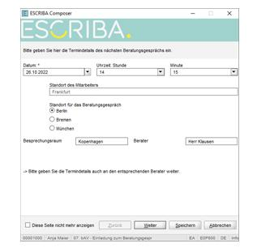


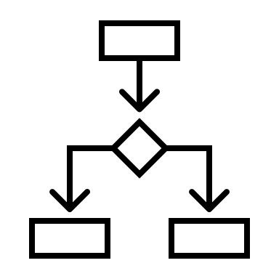














Data to Document to Data
Data and rules control the content and appearance of documents
Basic Layout
Input
Output
Physical format, fonts, and colors
Document
Types
Document template for letters, contracts, etc.
ESCRIBA Dialogues
Manually
Channels
Content
Texts, images, data, prompt-engineered content
(LLMs available on ECAP)
single or bulk documents or
document bundles
Backend Systems
Formats
Document Generation Rule Set
Rules (<if then otherwise> | <in case of>) apply to:
physical format, font, and colors (base template),
document type (document template for letters, contracts, etc.),
content (text, images, data), and
prompt-engineered content (all LLMs available on ECAP).
Notes:
Backendsysteme eine Quelle, ESCRIBA Dialoge die andere Quelle → optisch anpassen (beide Quellen Gleich groß)
Weniger Kreise, ggfs. Zahnräder
Daten und Regeln steuern Inhalt und Aussehen von Dokumenten (Subline)
Printer, Filing, Signature, Email, Spool
Document generation refers to the process of designing, writing, and formatting content that can be presented in various formats, such as text documents, PDF files, or presentations. In companies, this is a fundamental part of processes such as contract management, reporting, and communication, both internally with employees and externally with customers, suppliers, partners, applicants, and interested parties.

Slide 7



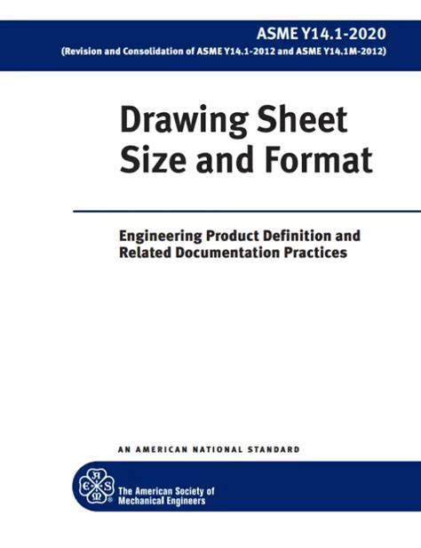




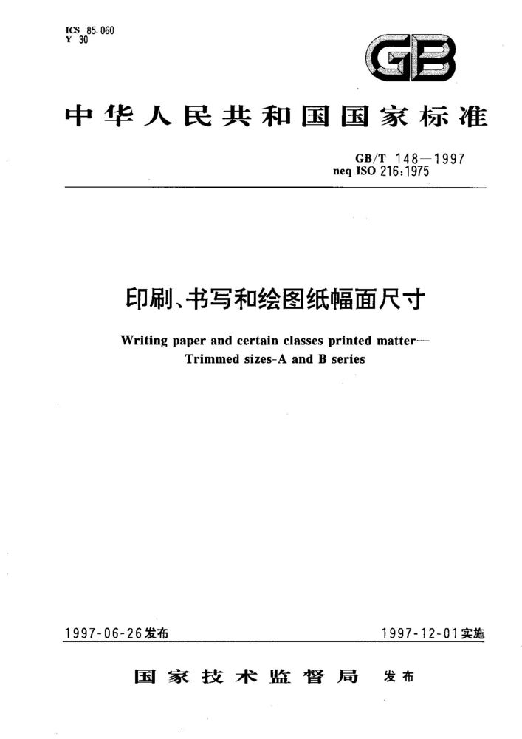



Basic Layout
Associated standards:
The basic layout defines the analog (physical) and/or digital form of the document.
Format (e.g. DIN A4 document, US legal letter, presentation slide, construction plan, email, RFID chip, etc.)
Character sets and font
Language and protocols
216
ANSE / ASMI Y14.1
In EDS, users manage and provide:
Fonts and associated styles (bold, italics, small caps, etc.),
Colors, and
Character sets for the company or group of companies.
GB/T 148-1997 (kāi)
JIS P 0202
Notes:
In practice, digital paper formats are created and managed here. Important standards in this area are ISO 216 (Europe), ANSE / ASMI Y14.1 (USA/CAM) with the formats Invoice, Executive, Legal, Letter, Ledger/Tabloid Broadsheet, China with GB/T 148-1997 (kāi) or Japan with the standard JIS P 0202.
A typical application example is that the date <Country> from the data record <Addressee> controls which paper format and font is used.

Slide 8
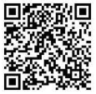
Document Types
Document Playbooks for Contracts, Letters, etc.
Use Case:
A typical use case is that subsidiary 1 uses a different letter layout than the parent company and the date <company code in the SAP backend> controls the relevant document template, or that the date <physical signature> from a signature process controls whether a document template with the barcode placeholder is used.
The document types allows you to define individual page types based on the basic layout.
Letter page 1, page 2 ff,
For contracts: Cover page, contract page(s),
signature page or,
For larger documents: Cover page, summary,
outline, table of contents, etc.
Text/ content and image anchors
(header, footer, and address lines,
logo and barcode positions, and
placeholders for the actual body
text with break properties)
Notes:
Vorteile bei der Datenverwaltung, da alle Inhalte (Objekte) in der Datenbank liegen
Drei verschiedene Visualisierungen von Layouts zeigen (Vertrag, Adresse rechts, plus vorhandenes) Barcode

Slide 9
Content
Texts, Images, Data, Rules, Prompts*
Content includes text, images, data, and data groups, as well as static or dynamic attachments. We refer to these as content objects:
Clause collections,
Offer texts,
Letters,
References,
Certificates,
Contracts, etc.
Granular ownership and editing rights on content includes:
Reading,
Variant-based editing,
Free editing
Content is not an integral component of the template(s), but is stored and administered separately in the database.
Thus, content can be locked against editing at the paragraph level including audit trail on which text sections were changed by whom, when and how.
Notes:
Abgrenzung: Inhalte liegen nicht im Template.
Regeln, Texte, Nbilder, etc. liegen in Datenbanken – können dadurch verwaltet werden
3-Stufige Ssysteme (Dev., Staging, Live, ggfs. Recovery)
Eingebauter Transportmechanismus
Domainspezifischer Transport – Transport der relevanten Inhalte, Support durch system-logische Fehlerprüfung
Berechtigungen, Zugriffsrechte
An important customer benefit is that content can be locked against editing at the paragraph level and, in the event of editing, it is possible to trace which text sections were changed by whom and how. This enables us to continuously improve the templates and clauses (paragraphs) at the system level.

Slide 10
ESCRIBA EDS: System Components
Document Generator – dort wo die Systeme integriert sind, Look and Feel vom Kunden, White label OEM (ECAP, SAP, SF, Workday, FileNet (?))
Darunter Document Composer (ggfs. Dialog-Maske EDS zeigen, beschafft Infos, um das Dokument zu bauen) und EIS (NLC Umgebung für die regelbasierte Datumenenerstellung: Integration und Functions (Umformatierung und Aufbereitung von Daten plus ESCRIBA Functions zur Datenmanipulation zur Formatierung)
Editor (Full-Word Processing Editor) nach dem Composing bearbeiten, Post Processing (Berechtigungsgesteuert)
Document Converters: aus internem Open Document Format (OASIS) ein externes Representationsdokument (PDF/A (XDP), Word, html, xml, etc.)
Document Designer (NLC Umgebung für das Gestalten von regelbasierten Dokumenten/ Dokumentcontainern) und EDS Operator aus separat / darunter darstellen
Document Job Management, System integration, look & feel of the customer, whitelabel OEM (e.g. ECAP, SAP, SF, Workday, FileNet)
Document Generator
Full-Word Processing Editor for (manual) post processing
Gathers information for building the documents
Editor
Document
Composer(s)
NLC environment for rule-based document creation: system integration and ESCRIBA Functions
Document
Designer
Enterprise Integration Server (EIS)
NLC environment for designing rule-based documents and document containers
Create an external representation document (PDF/A (XDP), Word, html, xml, etc.) from internal Open Document Format (OASIS)
Document
Converters
EDS
Operator
Synchronizes system components and transfers development statuses between project stages
Notes:
XDP files
Bundle of PDF/A+XML
Die Enterprise Document Services bestehen aus
· dem Enterprise Integration Server,
· dem Document Designer,
· dem / den Document Generatoren,
· dem / den Document Composern,
· dem /den Document Convertern
· sowie dem EDS-Operator.
Daten zwischen den Komponenten werden mit Hilfe von XML-Dateien, die an die Repräsentationen der Dokumente angehängt sind, transportiert. Damit ist für die Haltung dieser Daten keine eigene Datenbankanwendung erforderlich.
Innerhalb der EDS-Systemwelt werden Daten entsprechend dem OASIS Open Document Format for Office Applications, kurz Open Document Format (ODF), repräsentiert. Wenn Dokumente die EDS-Systemwelt verlassen, kann mit dem Converter festgelegt werden, in welche Format die ODF-Dateienüberführt werden sollen. In der Regel wird in XDP-Dateien, also ein Bündel aus PDF/A+XML konvertiert.

Slide 11

Distinctive Features of ESCRIBA EDS
Technical and system-related
One document generation for all your purposes: EDS is designed for multi-system and multi-client operation
The end of dark document data and clauses prevents the fragmentation
across systems and documents
Enterprize-ready with staging and domain-specific transport system
Read and write access to the backend system and simultaneous use of
multiple source systems for the data in the documents
Data and value lists from backend systems can be used in EDS dialogs,
enabling efficient workflows and secure document creation
Ownership and editing rights (including include reading, variant-based
editing, and free editing) can be defined for the content. These
transactions can be evaluated and used as process triggers themselves
Notes:
Zwei Folien daraus machen
Read and write access to the backend system and simultaneous use of multiple source systems for the data in the documents.Creation of individual and bulk documents as well as document bundles. In document bundles, several different documents are created and processed interdependently in a single process. A typical bundle is an email, an (attached but dynamically created) contract with attachments, and a zip archive with (static) applicable documents.Data and value lists from the backend systems can be used in the EDS dialogs, enabling efficient workflows and secure document creation.Ownership and editing rights can be defined for the content. Editing rights include reading, variant-based editing, and free editing. These transactions can be evaluated and used as process triggers themselves. E.g., “Inform the clause owner if the content of the clause has been changed using free text and wait for the corresponding approval before the next process step can be executed.”Follow-up document and variant EDS technology makes it possible to transfer data from a created document to a new document—the follow-up document. This allows complex process chains to be mapped. Follow-up documents are used when different base and/or document templates are required. Variants: With variants, the dialog entries remain as default values, while the text entries are reset. This allows different variants to be mapped quickly and reliably, even with extensive dialog entries.One Document Generation For All Your Purposes Enterprise Document Services are designed for multi-system and multi-client operation. All documents and all associated elements (base and document templates, text sections and clauses, data and data structures, dialogs, interfaces) can be used not only in the context of a specific system or process, but with any number of systems and in any context.The end of dark document data and clauses EDS technology provides the right tools to ensure that the content and appearance of documents comply with specifications and that it is always possible to trace whether and by whom content and data in documents have been changed. This prevents data fragmentation across systems and documents.Enterprise Ready With Staging And Domain-Specific Transport System The content of the documents is not managed in templates, but in databases. This avoids redundancies and, above all, ensures that the right content is used. Content maintenance and management are authorization-based. EDS technology is multi-tiered and enables domain-specific transport of content so that document development and quality assurance can take place even in larger distributed teams and decoupled from the go-live.

Slide 12
Distinctive Features of ESCRIBA EDS
Document and process related
Creation of individual and bulk documents as well as document bundles
Follow-up documents allow for data transfer from a created document to a
new one and make complex process chains mappable
With variants, the dialog entries remain as default values, while the text
entries are reset
Supporting >25 interface languages and up to 50 document languages
(mix and match) including rule-based language control for
automated switching
Notes:
Zwei Folien daraus machen
Read and write access to the backend system and simultaneous use of multiple source systems for the data in the documents.Creation of individual and bulk documents as well as document bundles. In document bundles, several different documents are created and processed interdependently in a single process. A typical bundle is an email, an (attached but dynamically created) contract with attachments, and a zip archive with (static) applicable documents.Data and value lists from the backend systems can be used in the EDS dialogs, enabling efficient workflows and secure document creation.Ownership and editing rights can be defined for the content. Editing rights include reading, variant-based editing, and free editing. These transactions can be evaluated and used as process triggers themselves. E.g., “Inform the clause owner if the content of the clause has been changed using free text and wait for the corresponding approval before the next process step can be executed.”Follow-up document and variant EDS technology makes it possible to transfer data from a created document to a new document—the follow-up document. This allows complex process chains to be mapped. Follow-up documents are used when different base and/or document templates are required. Variants: With variants, the dialog entries remain as default values, while the text entries are reset. This allows different variants to be mapped quickly and reliably, even with extensive dialog entries.One Document Generation For All Your Purposes Enterprise Document Services are designed for multi-system and multi-client operation. All documents and all associated elements (base and document templates, text sections and clauses, data and data structures, dialogs, interfaces) can be used not only in the context of a specific system or process, but with any number of systems and in any context.The end of dark document data and clauses EDS technology provides the right tools to ensure that the content and appearance of documents comply with specifications and that it is always possible to trace whether and by whom content and data in documents have been changed. This prevents data fragmentation across systems and documents.Enterprise Ready With Staging And Domain-Specific Transport System The content of the documents is not managed in templates, but in databases. This avoids redundancies and, above all, ensures that the right content is used. Content maintenance and management are authorization-based. EDS technology is multi-tiered and enables domain-specific transport of content so that document development and quality assurance can take place even in larger distributed teams and decoupled from the go-live.

Slide 13
Advantages at a glance
Documents are always up to date and compliant
Granular access rules
Reduced number of templates and maintenance effort
Seamless integration into existing IT landscape
Automated, streamlined processes
Time and cost savings

Slide 14
What Can (Generative) AI Do for Document Creation?
Basic Capabilities
Generates and formats text into documents.
Limited formatting and rendering capabilities.
Export possible into target systems (e.g., JSON format).
Important
Always validate AI outputs –
hallucinations remain possible
Key Requirements for High-Quality Output
Excellent prompt engineering & prompt management
Data handling + backend system access (e.g., SAP fields)
Strong rights management
Use of Retrieval Augmented Generation (RAG) for company content
Calculation tools and formatting languages for styling
Dialog validation for user inputs
Integration server for workflows & interoperability
Management of dynamic/static attachments and bundles
High performance for volume document generation

Slide 15











Combining Convenience of the AI User Interface and Compliance of the Capsuled Document Generation
= Perfect Answer to the Key Restrictions towards the Use of AI in Enterprises
Agentic AI
Wizard to be replaced by AI Agent to interact with end user based on data requested by rule engine through API
Strong position
against 100% AI generated documents
(zero compliance)
User Interaction
modern
convenient
efficient
API
a
READY TO USE
Document Compliance
RULE ENGINE
DATA INTEGRATION
CLAUSES

Slide 16









Document Generation: AI vs. EDS
Limitations of AI
Language models cannot fully replace Enterprise Document Services (EDS).
A powerful application is needed to extend AI with essential features.
ESCRIBA EDS Strengths
Uses playbooks (not prompts) and rules (not RAG) for reliable content.
Ensures accuracy, compliance, and high performance.
Lower energy consumption compared to GenAI-based systems.
Strategic Role of AI at ESCRIBA
Language models are seen as UI technology (natural language dialogs).
AI is useful where ESCRIBA coverage is not (yet) complete.
Two approaches:
1. Prompting Machine: Pre-set inputs controlled by EDS.
d
2. AIDoG (NLC Environment): AI-driven document creation integrated with EDS
(data, rendering,
transfer).

Slide 17






ECAP Product Strategy and Roadmap
ECAP.One (NLC|AI Platform)
EDS (ESCRIBA Document Services)
eFiling/DMS
AgentGraph
EIS (Enterprise Integration Server)

Slide 18
EDS (ESCRIBA Document Services)
Q1/28
New Designer 0.2
- Manage Switches, Layouts, Basetemplates
New Designer Release
- Full replacement of existing RichClient
Multidistribution Channel
- Define multiple output channels for document-sets of a single job
Q1/27
Q1/26
Q1/25
Q2/25
Q3/25
Q4/25
New Designer 0.1
- Textblockmanagement
DAAM
Permissions for Users/Roles on Clause level
Manage permissions on document instances during creation/negotiation process
Cluster mode Support
Major
Minor

Slide 19
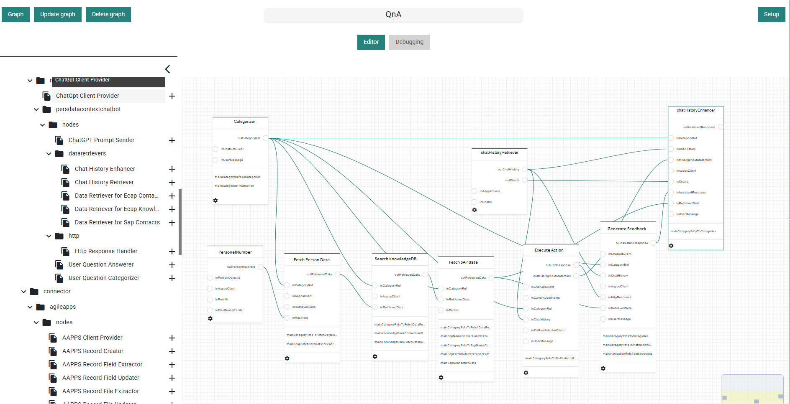

Slide 20
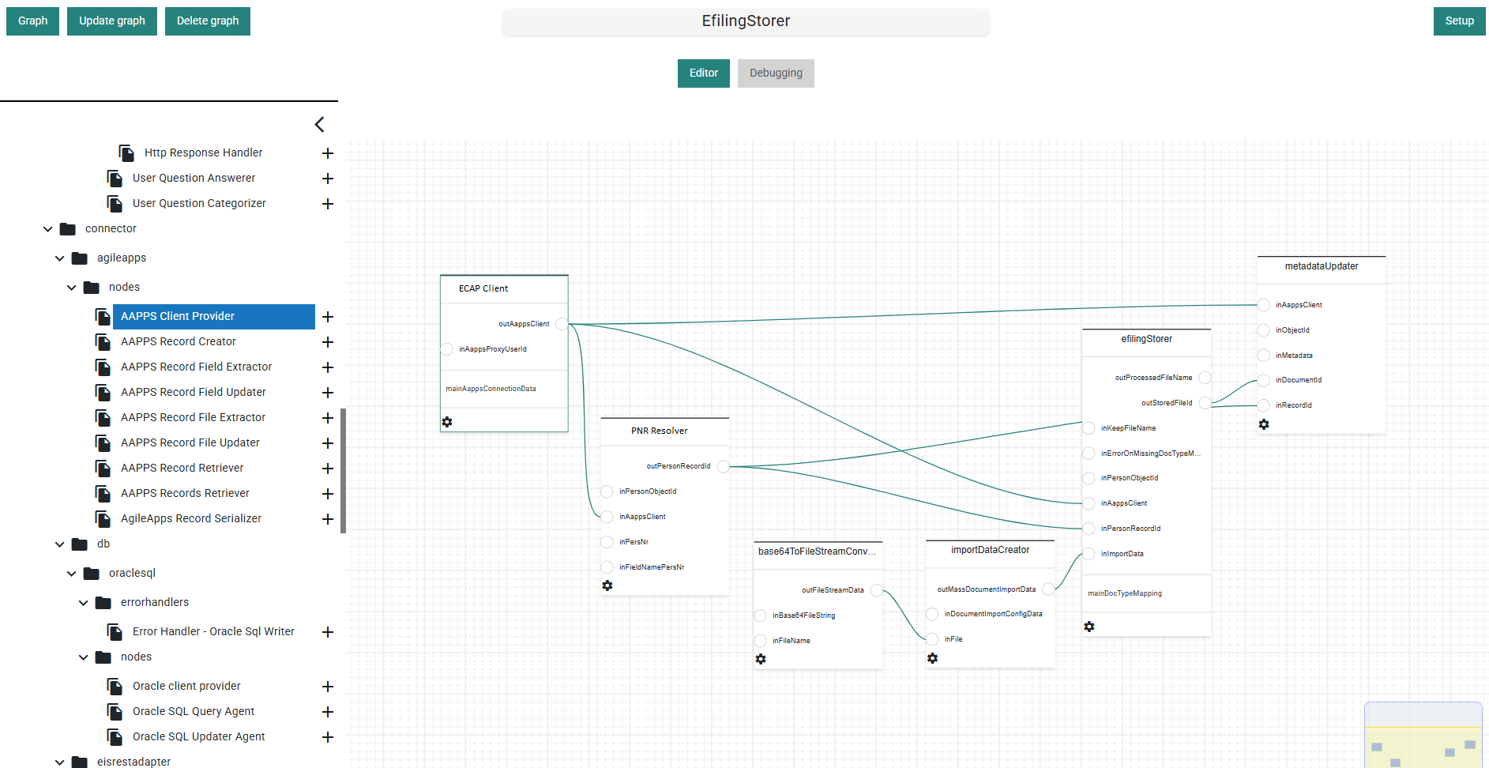

Slide 21
LIVE DEMO

Slide 22

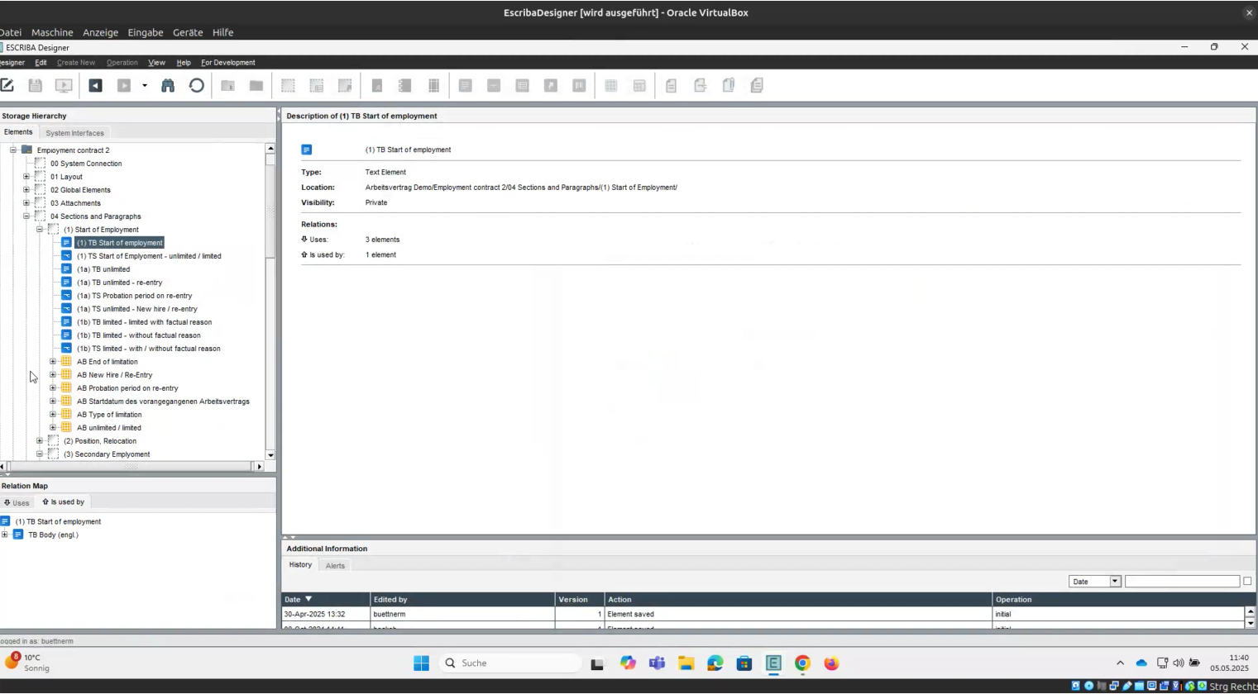
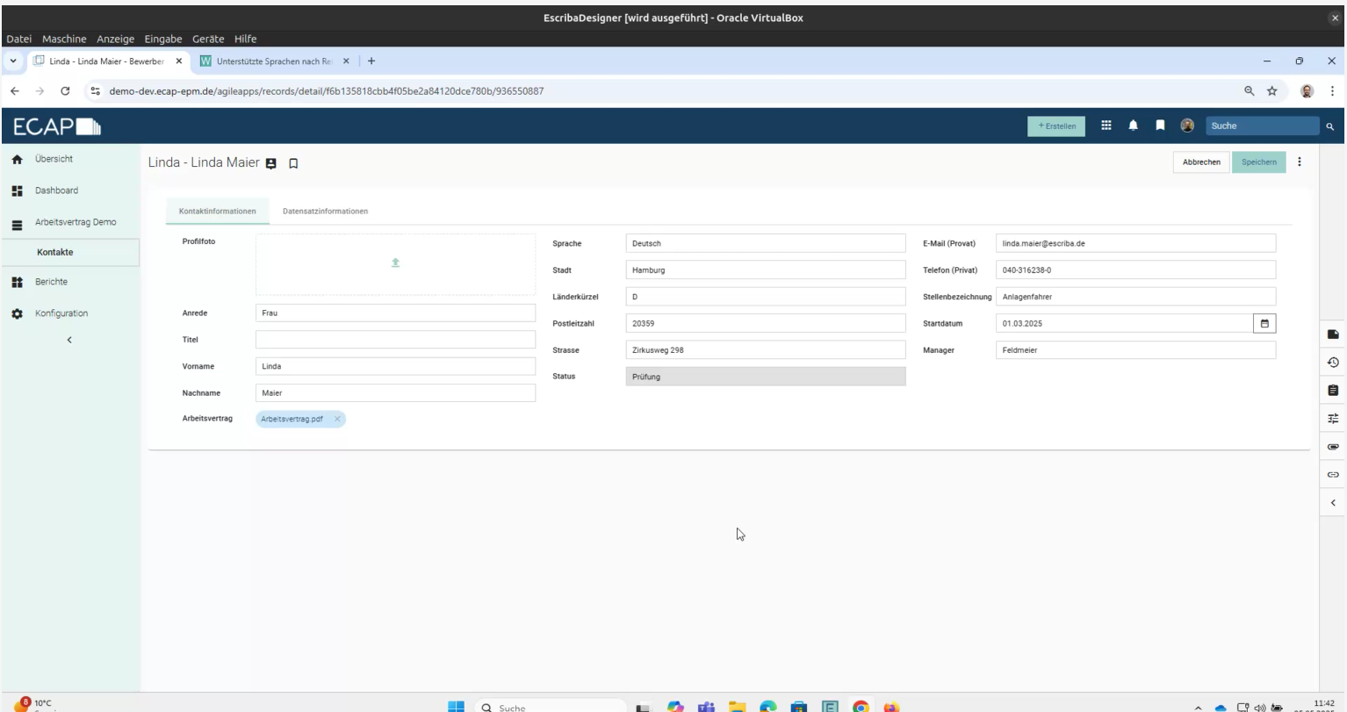
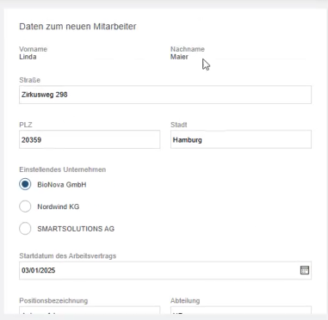
Live Demo: Access Points for Different Users
Part 1:
Business User CREATES a Work Contract
Here: Starting in ECAP
Part 2:
Document Designer DESIGNS
Doc-Types, Rules and Data Access
DESIGNERS
BUSINESS USERS

Slide 23


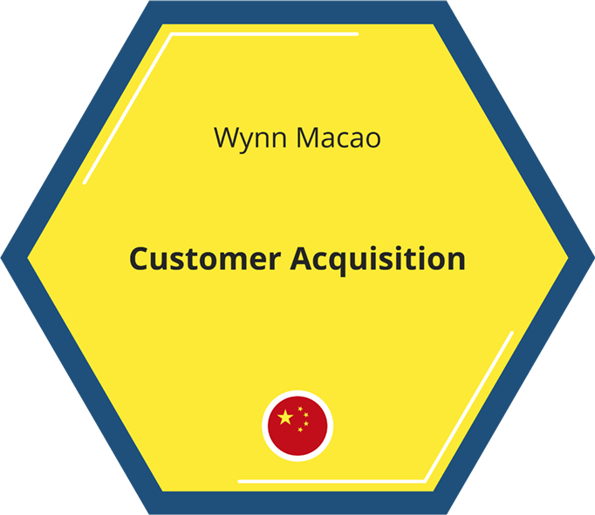
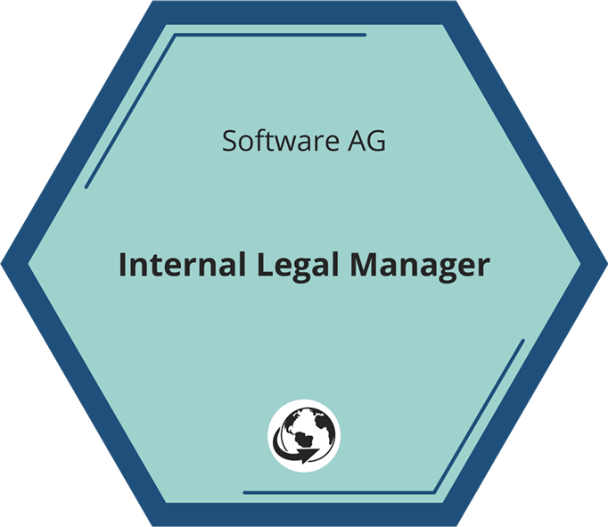
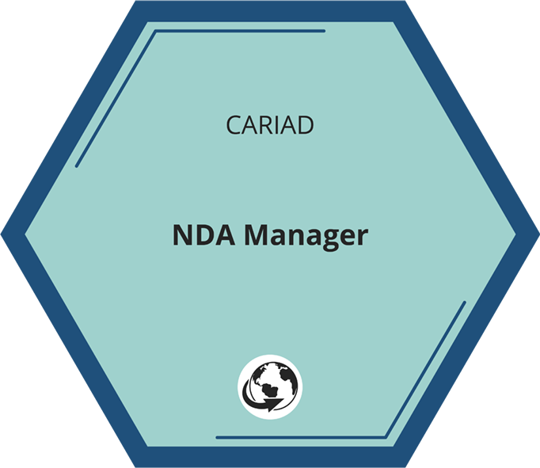
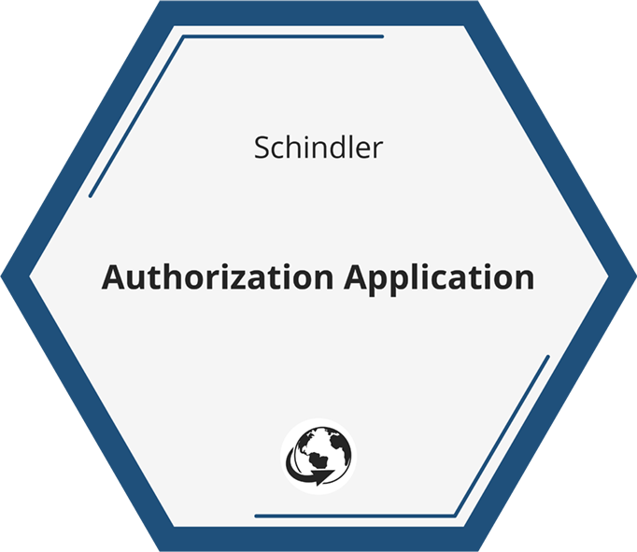
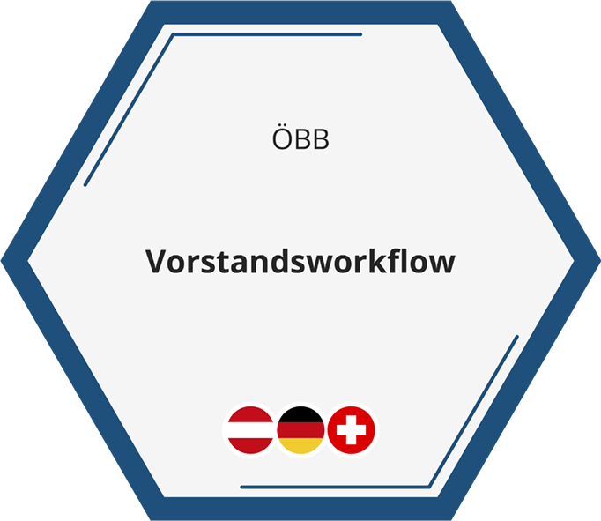

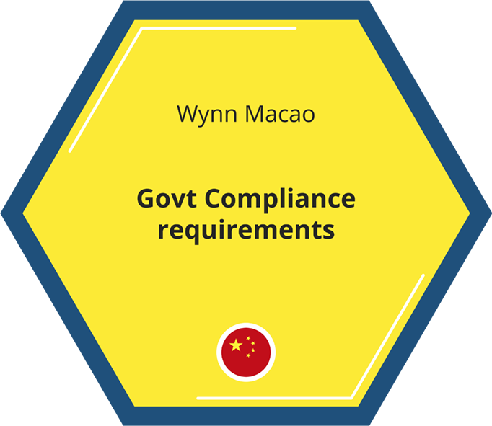
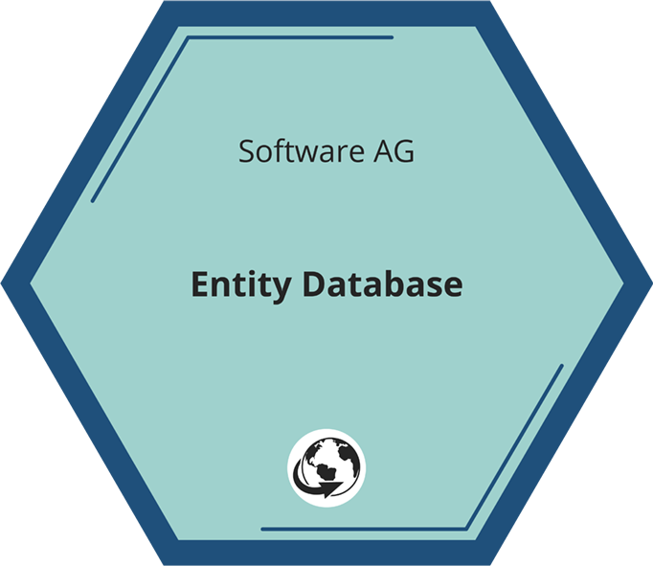
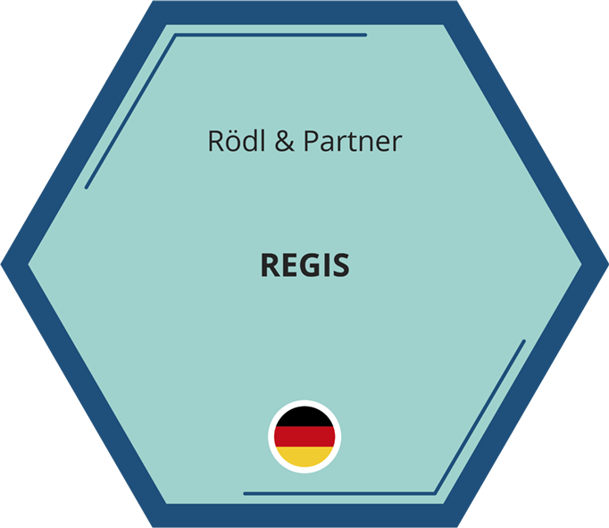
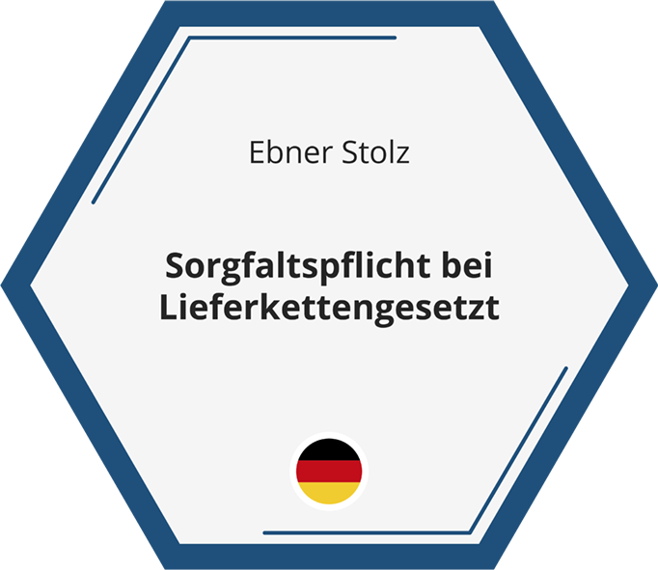



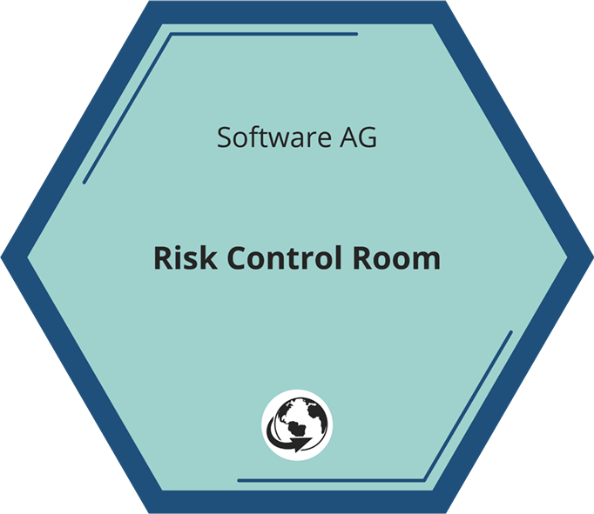
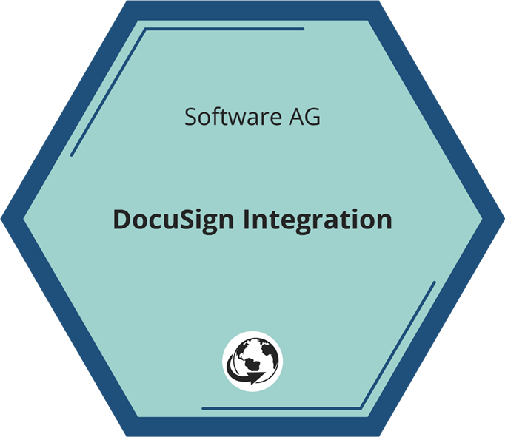
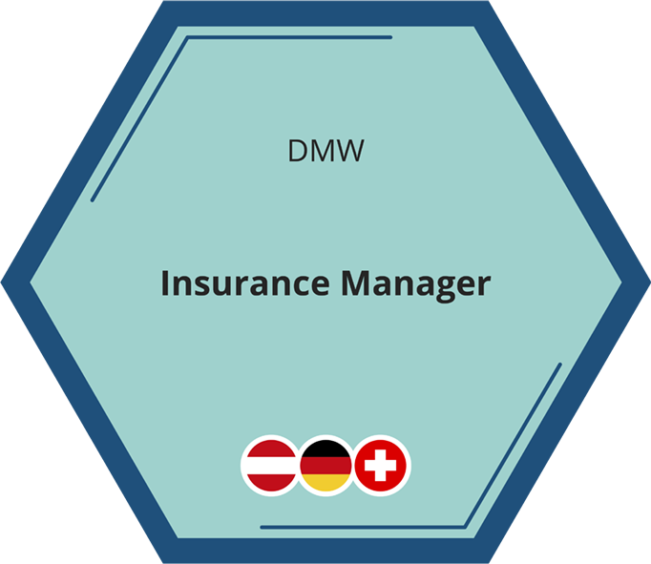
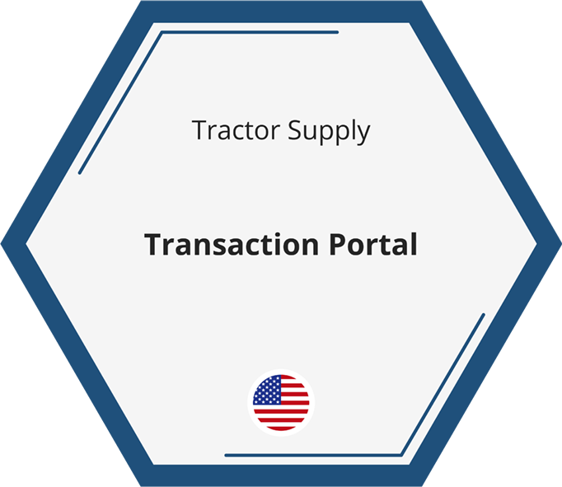


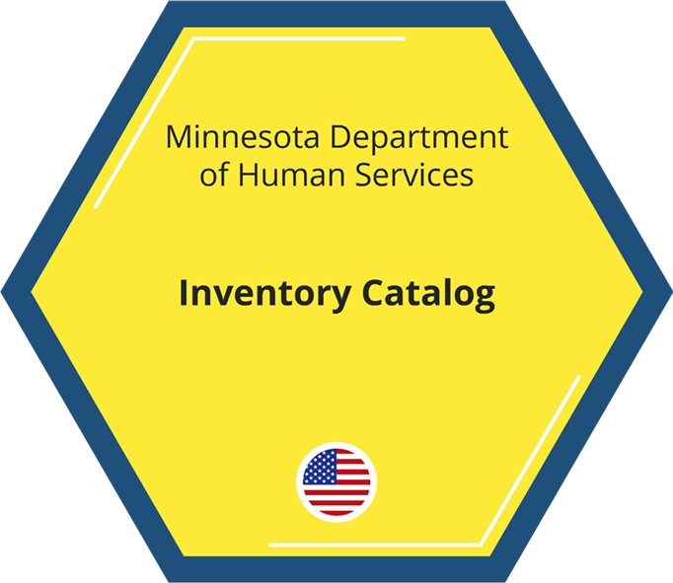
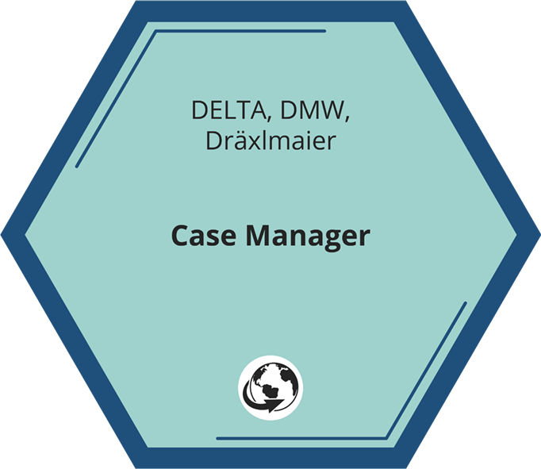

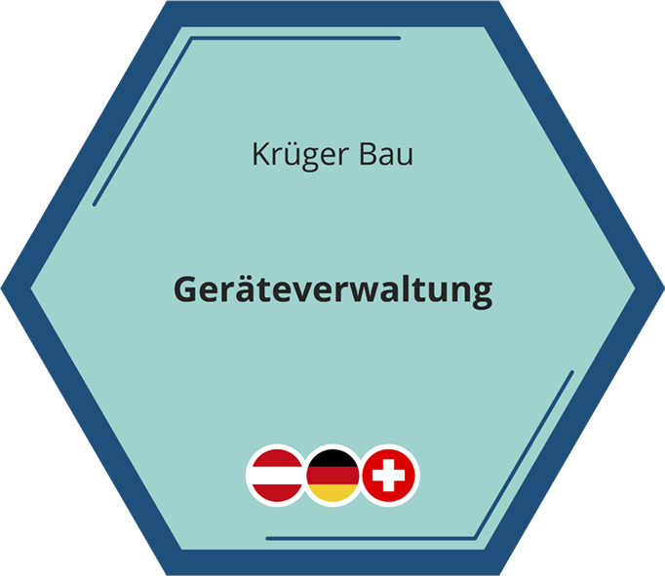
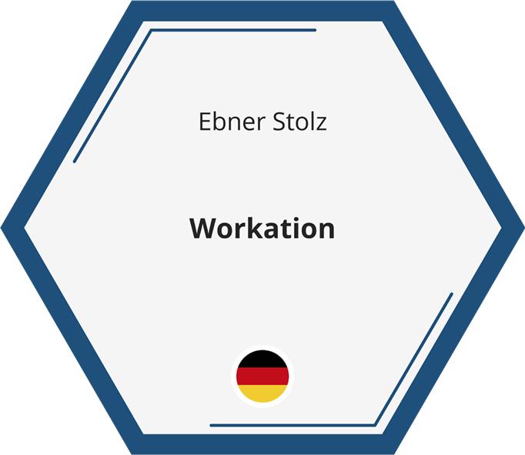

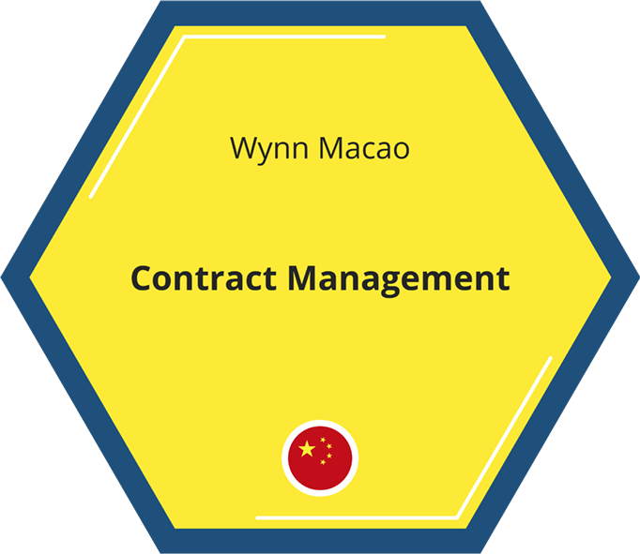
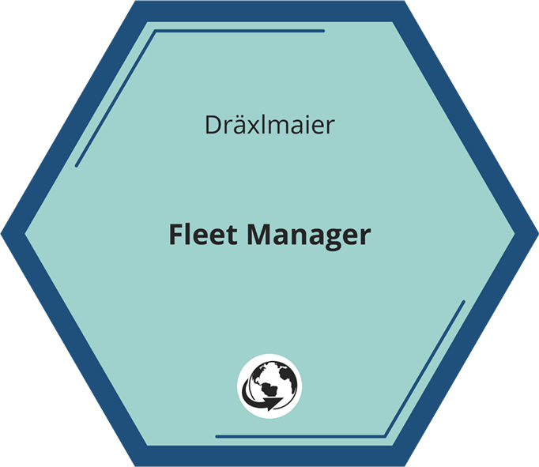

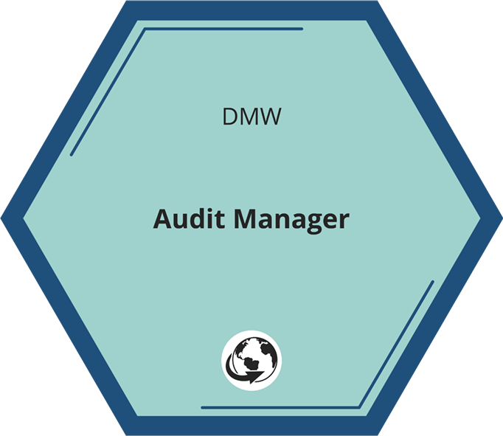
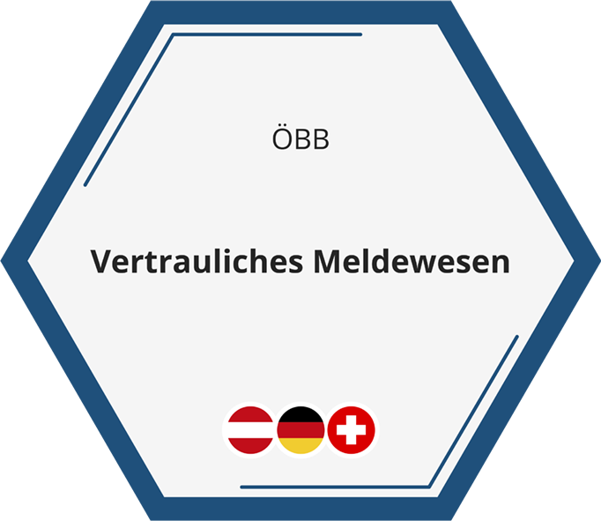


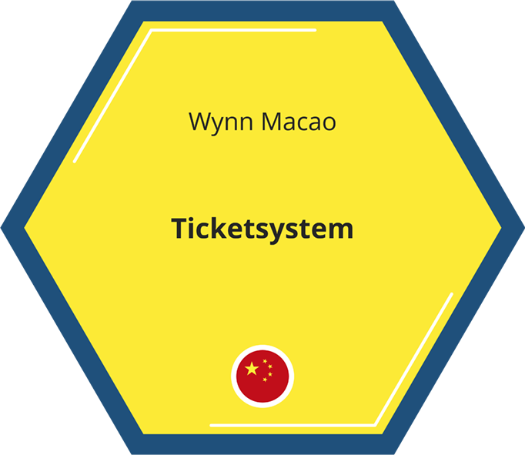
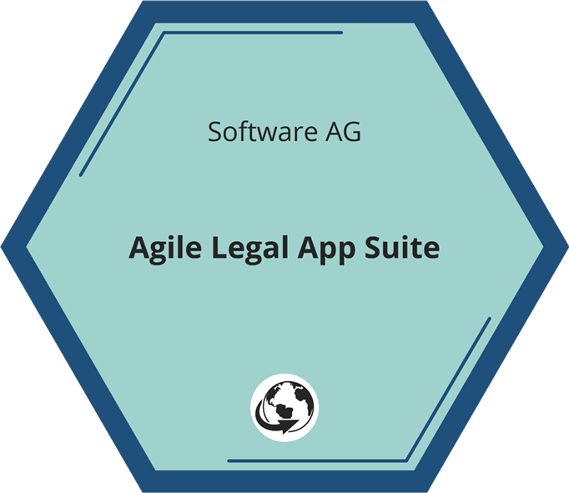
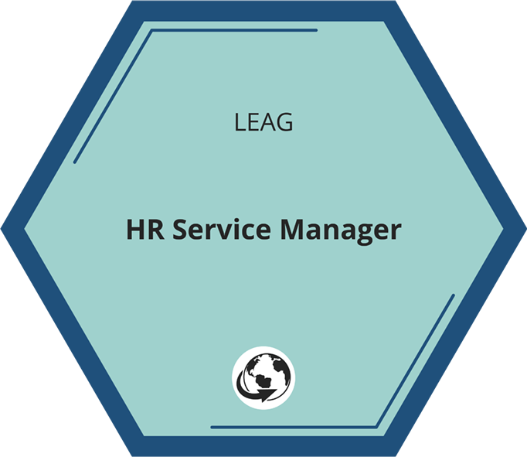
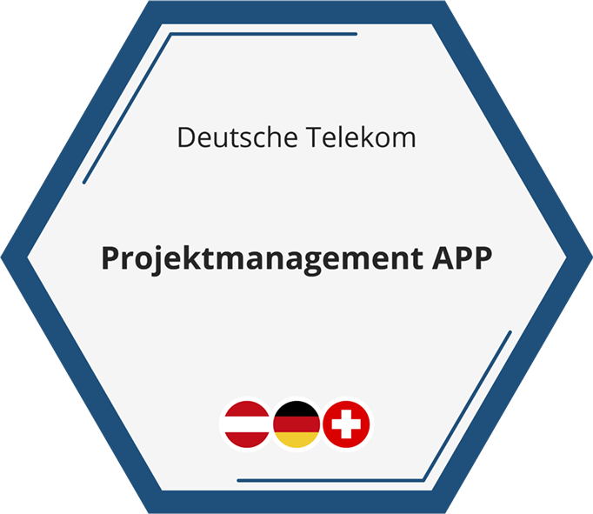
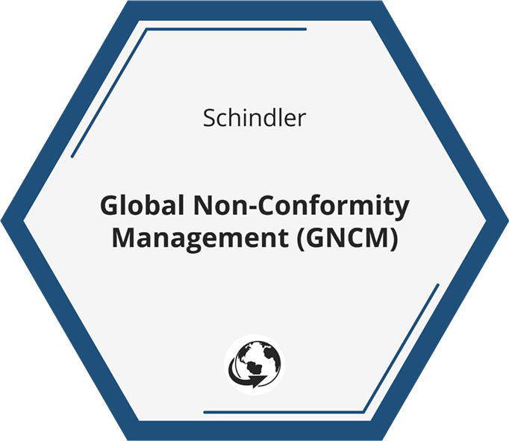
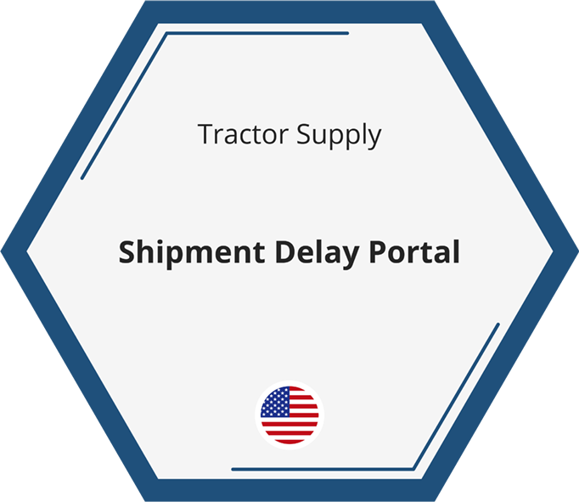
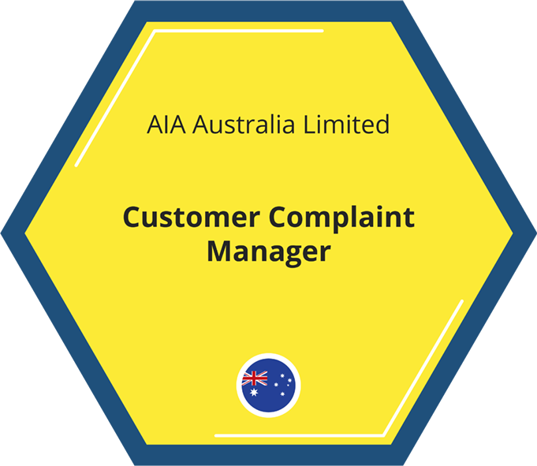
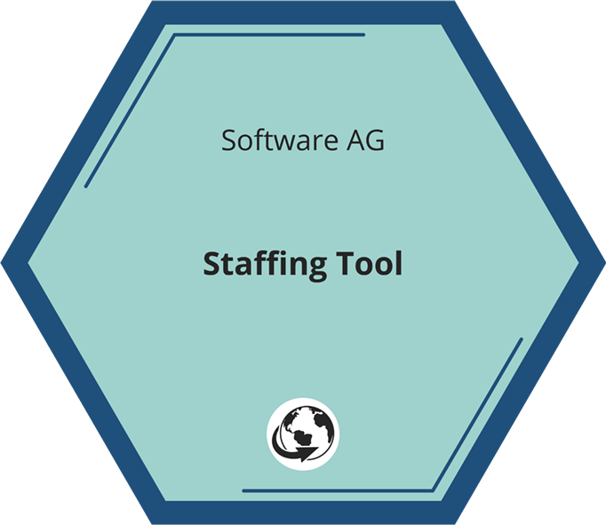
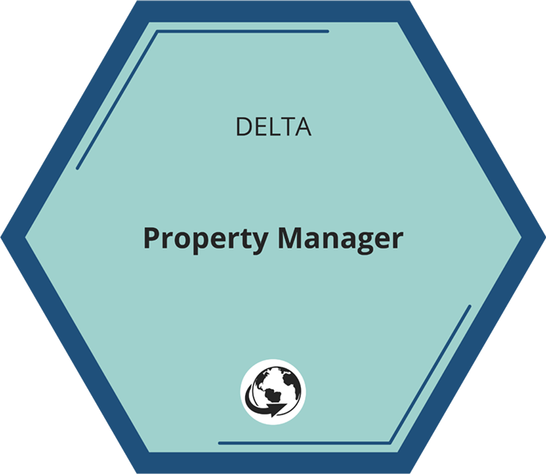
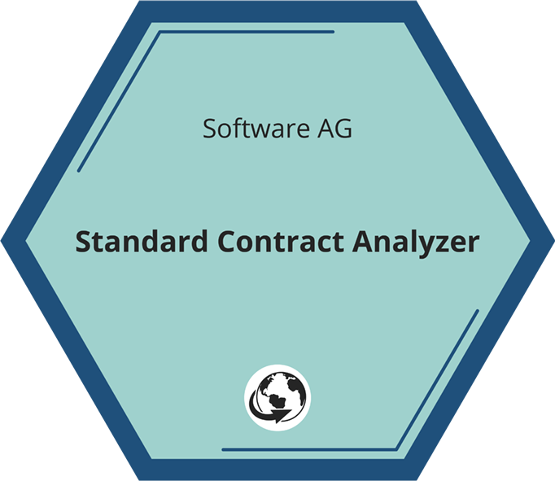





Thank you!

